Slide 1
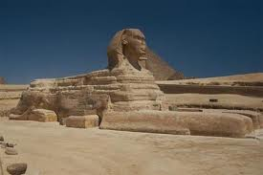
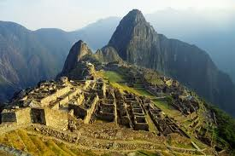
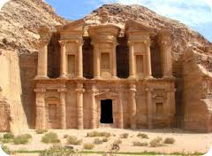
INVESTIGATING THE PAST
HISTORY, ARCHAEOLOGY,SCIENCE

Slide 2
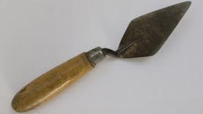
What is archaeology?
A means of studying the human past through physical remains (artefacts).
Critical for understanding people who did not leave behind written records.
Learn a lot more about everyday people often left out of official records.

Slide 3
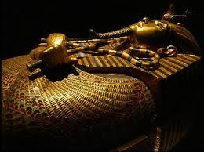
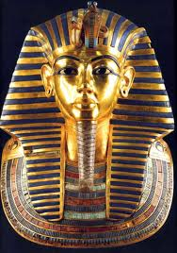
Why is archaeology important to the study of history?
Together with History, archaeology enables us to study all aspects of human activity.
Archaeology helps the Historian reconstruct the past.

Slide 4
Working together – Tutankhamen’s Tomb
The Historian
Stelas (stone tablets/ monuments)
Tomb inscriptions
Inscriptions on statues
Official documents
Writings on burial goods
The Archaeologist
Tombs in the Valley of the Kings
Burial goods
Mummified body
Wall paintings
Temples
Notes:
https://www.youtube.com/watch?v=Avqafc6fZwc

Slide 5
Working in the trenches
Like a post-mortem – every piece of evidence is examined in great detail to gain information and interpret what has been found.
Sir Mortimer Wheeler was the first archaeologist to employ the box grid system. The site is divided into squares (boxes) and each square is numbered and then excavated leaving a baulk (wall) in between.
The baulk provides a vertical record of the layers dug (strata) and each one is labeled, as is everything found within them. The baulks may be removed later to reveal the overall nature of the site.
Open-area excavation is the most common method used today – site is uncovered layer by layer.

Slide 6
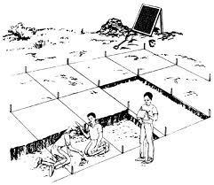
BOX GRID SYSTEM

Slide 7
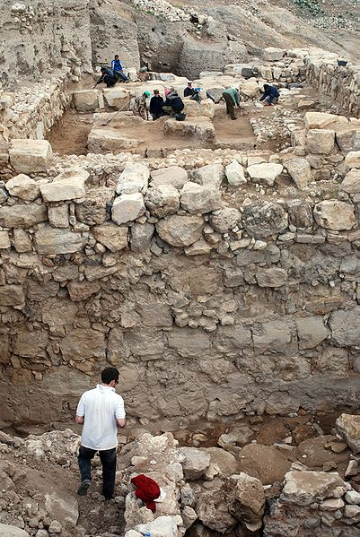
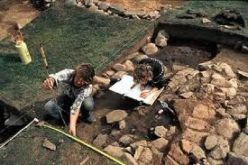
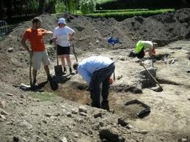
Archaeologists at work
Notice the grid system.
What tools are the archaeologists using?
Unfortunately, even the act of digging destroys evidence!
Notes:
Diagram on right: A view to the east showing work in the Migdol Temple precinct during 2007. In the foreground a large multi-roomed Iron Age (ca. 900 BC) complex is being excavated, while in the background, work is being undertaken to investigate deposits beneath the Middle Bronze Age temple structure (>1650 BC). Note the massive west exterior wall of the Migdol Temple seen in this image.

Slide 8
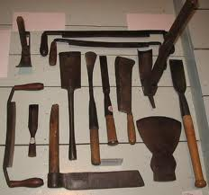
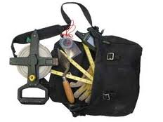
Tools of the trade
A trowel is essential but archaeologists use a wide range of tools and equipment from bulldozers to cotton gloves.

Slide 9
Destruction of evidence
Warfare is an easily recognizable cause for destruction of evidence.
Tomb robbers and looters both in antiquity and modern times have taken and destroyed much evidence.
Pollution in the modern age is destroying many ancient monuments and sites .Smog has been destroying stonework in Athens. Sewerage in Egypt has caused problems to its ancient monuments.
Tourism – for e.g., brown bacterial growth on the walls of Tutankhamen’s tomb caused by the 25 litres of human sweat that condense there every day.
Plants, rat, mice, insects, fungi and bacteria can all degrade a site.

Slide 10
Site preservation
Different materials decay at different rates.
Textiles, papyrus, wood and parchment are destroyed easily and unlikely to survive except in desert conditions. Heat and absence of moisture prevent decay. However the acidic soil in peat bogs help prevent decay and act like a refrigerator in cold climates.
Under normal conditions metals such as gold and silver survive .Iron rusts and bronze decays. Stone and pottery are almost indestructible. Pottery is an invaluable dating tool.
Calcium in the soil may turn bones to stone.

Slide 11
Dating finds
The Danish scholar C.J. Thomsen (1788-1865) devised the sequential three-age dating system based on the technology of stone, bronze and iron.
Each of these three ages is further divided into early, middle and late periods.
The Stone Age is divided into Palaeolithic (palaeo = old, lithic = stone), Mesolithic (‘Middle Stone’) and the Neolithic (‘New Stone’). Similarly, the Bronze and Iron Ages are divided into periods reflecting major phases in culture and technology.

Slide 12
Dating finds II
Radiocarbon or Carbon-14 dating is probably the most useful.
All living things absorb Carbon-14 – a radio-active isotope of carbon. This process stops at death and the Carbon-14 begins to decay. After 5730 years, 50% has decayed – scientists call this the ‘half-life’ of the isotope. At around 40,000 to 50,000 the level is almost zero.
Carbon-14 dates are usually expressed BP plus or minus so many years. (BP = Before Present, with 1950 the ‘present’, the year Willard Libby developed the Carbon-14 method)

Slide 13
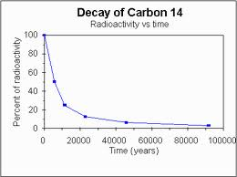
Dating methods
Some common dating methods include;
Carbon-14 dating
Dendrochronology
Thermoluminescence
Fluorine testing
Stratification
DNA
Cross-dating

Slide 14
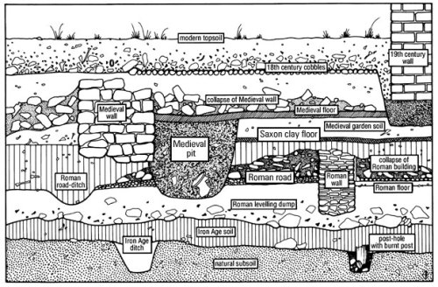
Stratigraphy
Layers of soil or other materials are deposited in the past in chronological order, with the oldest layer at the bottom.

Slide 15
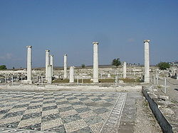
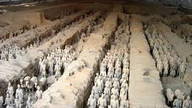
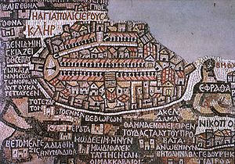
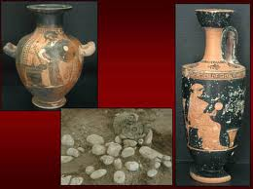
finds

Slide 16
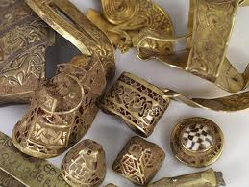
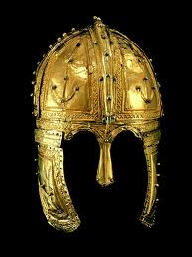
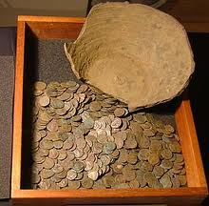
More finds
http://news.nationalgeographic.com/news/2008/12/081219-top-ten-archaeology.html

Slide 17
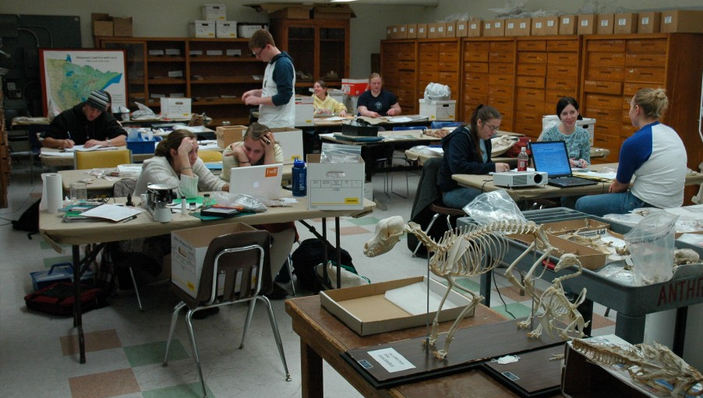
Work beyond the trenches
Forensic Science: spectrographic analysis, x-ray defraction, electron microscopy and neutron activation analysis provides information on how long someone has been dead, how they died and the environment in which they lived.

Slide 18
Skills of an archaeologist
Evaluates material evidence
Records excavated material
Interprets evidence and draws conclusions
Classifies evidence placing it in its correct context and time
Communicates and explains theories about the past

Slide 19
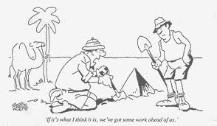
Tip of the…

